Slide 1
AI-Generated Media and Entertainment
Daniel Sung, Flora Huang, Steven Li, Owen Bartlett

Slide 2
BACKGROUND
Generative AI can create images and video from text prompts and visual references.
Its uses can range from smaller vfx tasks to fully synthetic scenes and short films. [1, 2]
Capabilities and production changes
Evidence from filmmaking
Images and video. Adobe Firefly and Runway generate storyboards, images and short clips. They can animate still images or add backgrounds and visual effects. [1, 2]
AI Film Festival. Nearly 6,000 submissions in 2025, up from 300 in its first year. Entries had to include AI-generated video. [3]
Creative control. Reference images help maintain characters and style across shots. Creators select outputs, revise prompts and edit results within existing production workflows. [1, 2]
Here (2024). Generative AI portrayed Tom Hanks at five ages and Robin Wright at four. Metaphysic combined live previews with artist refinement. [4]
Production speed. Netflix said AI helped finish a building-collapse sequence for the TV series The Eternaut 10× faster than traditional VFX. The claim covers one sequence. [6]
Studio investment. Lionsgate took an equity stake in Runway in June 2026 and announced a joint program to develop new content. [5]
Controversy: authenticity and creative work
Audience trust. YouTube requires disclosure of realistic AI-generated or meaningfully altered content, including fabricated events or people doing things they never did. [7]
Creative labor. The video-game actors’ 11-month strike ended in 2025 with a contract addressing consent and compensation for AI replicas. [8]
[1] Adobe Firefly [2] Runway Gen-4 [3] AP: AI Film Festival, 2025 [4] Metaphysic / AWN: Here, 2024
[5] Runway–Lionsgate, June 2026 [6] Reuters: Netflix, July 2025 [7] YouTube policy [8] AP: performers’ contract, 2025
Notes:
Daniel

Slide 3
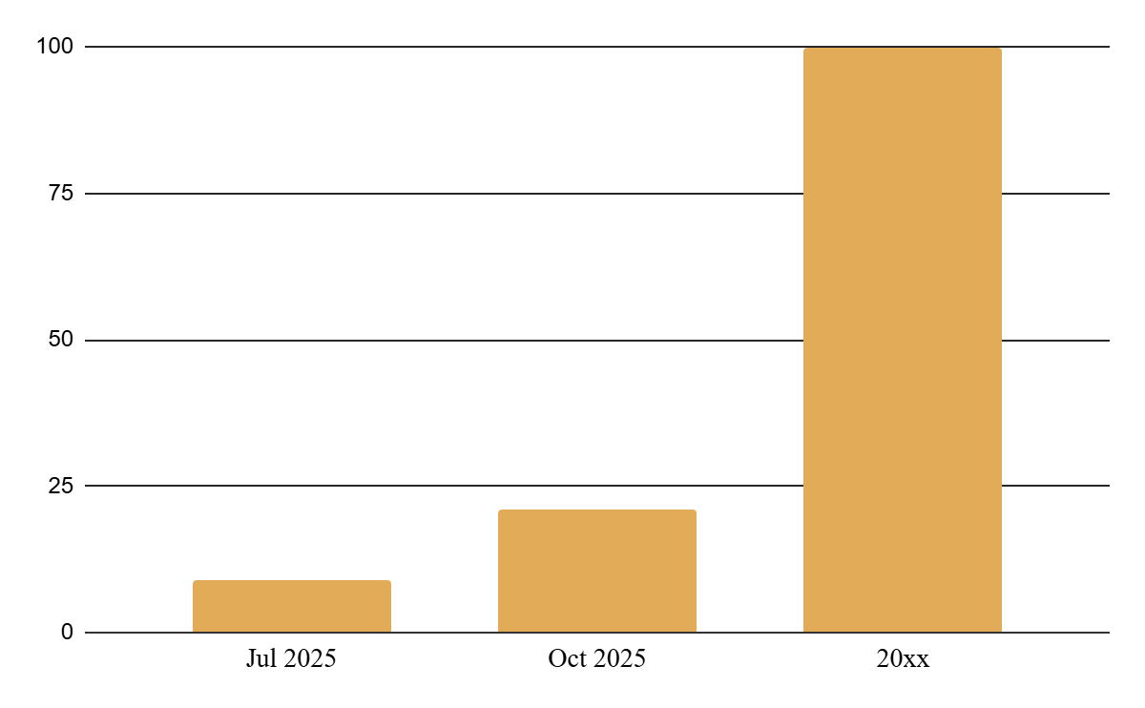
ANALYSIS
Completely Restructures Media Landscape
AI-generated media is essentially indistinguishable from non-AI content
Reframing of AI-generated media from “AI slop” to conventionally accepted method of creation
Ability to create media no longer gated by access to traditional distribution outlets or industry connections, but by access to AI generation tools
What if AI-generated media becomes completely indistinguishable from human-made content?
Approaching 100% adoption of AI-generated media content
Traditional Media Industry Breaks Down
US media and entertainment industry valued at $649 billion: film and television employs 2 million people and pays $200 billion each year in wages
At extreme, traditional media institutions completely discarded: consumers interface directly with AI to generate personalized content and entertainment
9/100 fastest-growing YouTube channels make purely AI-generated content
21% of shorts recommended to new accounts are AI-generated
Implications Beyond Entertainment
When seeing is no longer believing, many aspects of daily life can no longer be relied upon:
Online customer support interactions that use photo or video as evidence of product defects
Authenticity of media evidence in the news
Video evidence in the courtroom: used in 80% of crime cases
The Guardian, Cat soap operas and babies trapped in space: the ‘AI slop’ taking over YouTube
Kapwing, AI Slop Report: The Global Rise of Low-Quality AI Videos
International Trade Administration, Media & Entertainment
Motion Picture Association, Driving Local Economies
Bureau of Justice Assistance, Video Evidence

Slide 4
Opportunities
The Provenance Gap
Synthetic capture has become indistinguishable from recorded capture, and no institution owns the job of establishing which is which. The notary function of media — this happened, here, then — has no holder.
Is it real
Courts, insurers and newsrooms adjudicate authenticity case by case with no shared standard, and detection accuracy falls as generation improves.
Is it important
Proof of origin is an input to claims, contracts, evidence and elections. When it fails, the cost lands on institutions that must decide anyway.
Is it addressable
Attestation at the point of capture is technically solved. What is missing is a standard and a first adopter — commercial, not research.
The Authenticity Premium
As synthetic supply approaches infinity, human origin stops being the default condition and becomes a claimable, priceable attribute — while the claim itself stays unverifiable and self-asserted.
Is it real
Willingness to pay for human-made is visible in live performance and named-byline work, but nothing separates the honest claim from the cheap one.
Is it important
Every industrialized craft grew a certified counter-market. The durable margin accrued to whoever owned the audit, not to the maker.
Is it addressable
Certification needs a defensible audit method, and that depends on the provenance gap closing first. Sequenced, not parallel.
The Accountability Vacuum
Synthetic publishing scales output past the point where any human reviewed it, while liability still assumes a publisher who did. Volume grows; the party who answers for it disappears.
Is it real
Output already exceeds review capacity. Case law is unsettled and the first large judgments have not landed.
Is it important
Unpriced risk blocks adoption. Anyone wanting to publish at machine scale needs a party to absorb the tail, or the work does not ship.
Is it addressable
Pricing requires loss data that only exists after claims are made, so position is won early and compounds.

